Slide 1
Generation Equality Forum
France
Health and Solidarities Ministry
Social Cohesion General Direction
(DGCS)
Alexis Rinckenbach
Head of the bureau of European and international affairs
7-8 May, Mexico
7-10 July, Paris

Slide 2
Overview of the presentation
What is the Generation Equality forum?
What are the forum’s goals?
How can Member States be active participants to the forum?

Slide 3
Une stratégie divisée en six axes de priorité
What is the Generation Equality Forum?

Slide 4
An event convened by UN Women and co-chaired by Mexico and France
Organizer
Co-chairs

Slide 5
An event that marks the 25th anniversary commemoration of the 1995 Beijing Platform for Action
A result of the 1995 World Conference on Women, the Beijing Platform for Action remains the most progressive and consensual international blueprint on the advancement of women’s rights.

Slide 6
The Forum is the culmination of the Beijing Platform’s 25th aniversary review process
The Generation Equality Forum will be informed by:
the Beijing+25 multi-stakeholder regional meetings and consultations;
the 64th session of the Commission on the Status of Women (UN headquarters, 9-20 March 2020).

Slide 7
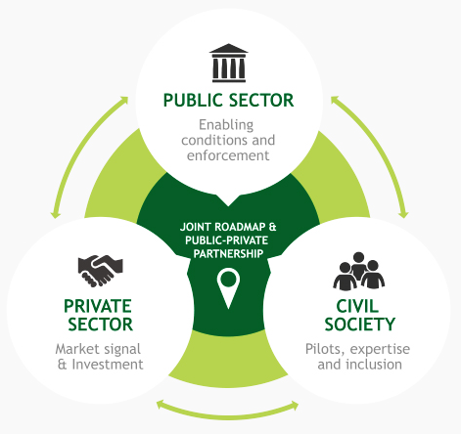
The Generation Equality Forum is designed as a multi-stakeholders approach
The Forum will set a major emphasis on dialogue and parterships between civil society and Member States – and, to a lesser extent, businesses.

Slide 8
The Generation Equality Forum, a two-pronged event
The Forum will kick off in Mexico (7-8 May, 2020)…
… and culminate in Paris
(7-10 July, 2020)
The event will bring together 2,000 participants.
Government representatives are expected.
Preparatory work for the Forum’s Paris event will be laid down.
The event will bring together 5,000 participants.
Head of States or head of governments are expected (around 50 total).

Slide 9
Une stratégie divisée en six axes de priorité
What are the goals of the Generation Equality Forum?

Slide 10
Objective N.1 - Assessing the global situation of women 25 years after the 1995 Beijing Conference
As the largest UN conference about women’s rights since 1995, the Forum will take stock of progress and setbacks registered for the past 25 years.

Slide 11
Objective N.2 - Triggering a feminist dynamic
The Forum will foster a gender equality momentum
The event will enjoy a broader coverage than any previous global event about women’s rights.
Participants will draft an agenda of concrete actions to realize gender equality by 2030. This agenda will be the main communication output of the Forum.

Slide 12
Objective N.3 - Favouring swift, specific and accountable changes
States will be free to join “Action Coalitions”
Action Coalitions are thematic-based partnerships between NGOs, States, and private sector.
These Action Coalitions will develop a set of concrete and measurable steps to create a real impact in a five-year period.
The Action Coalitions’ blueprints will be developed during the first part of the Generation Equality Forum, in Mexico.

Slide 13
Objective N.3 - Favouring swift, specific and accountable changes
The six Action Coalitions of the Forum
Putting an end to sexist violence.
Reinforcing sexual and reproductive health and rights.
Reducing women’s vulnerability to climate change.
Increasing women’s access to technology and their role in innovation.
Helping feminist organizations to thrive around the world.
Guaranteeing economic autonomy for every women.
Notes:
Seules les thématiques sont définitives, pas les intitulés exacts.

Slide 14
Une stratégie divisée en six axes de priorité
How can Member States be active participants to the Generation Equality Forum?

Slide 15
Attending the Generation Equality Forum - Prerequisites
In order to attend the Forum, States must:
Have their head of States or of government represent them in the Paris event (7-10 July 2020);
join one action coalition and pledge to respect its specific agenda of measures and investments.

Slide 16
Attending the Generation Equality Forum - Optional
In order to participate more actively to the Forum, States may:
join several Action Coalitions – instead of one;
act as the leader of a particular Action Coalition.

Slide 17
Generation Equality Forum
France
Health and Solidarities Ministry
Social Cohesion General Direction
(DGCS)
Alexis Rinckenbach
Head of the bureau of European and international affairs
7-8 May, Mexico
7-10 July, Paris

